Slide 1
Identifying Transmembrane Helices in Tertiary Structures
SSBI – Project 3
Marco Klein, Julian Späth, Julius Vetter

Slide 2
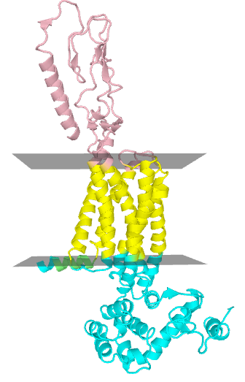
Transmembrane (TM) Proteins
Perform many important physiological tasks
Molecule transport
Cell signaling
Contained substructures
Helix bundle
Beta barrel

Slide 3
Motivation & Goal
Only few determined tertiary structures
PDB entries have no information on membrane topology
Calculate Membrane Geometry
PDB
Entry
Is helix TM?
Helices
TM
Helices
Classifier

Slide 4
Data Processing
PDBTM Database
Annotates transmembrane regions in proteins
Find overlap between
Annotated TM regions (PDBTM)
Helix regions (PDB)
Overlap ≥ 70% → positive samples = 0% → negative samples
Additional neg. samples from globular proteins

Slide 5
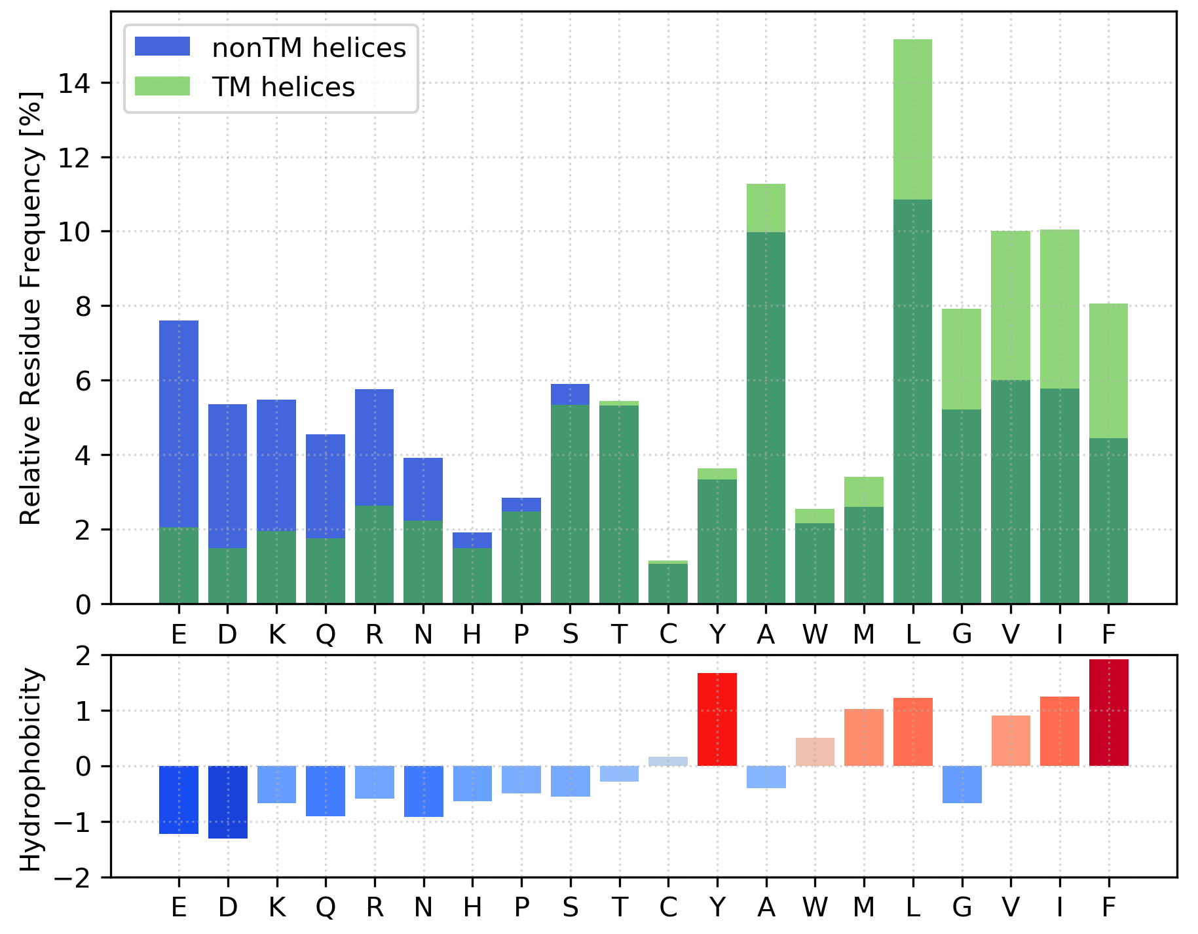
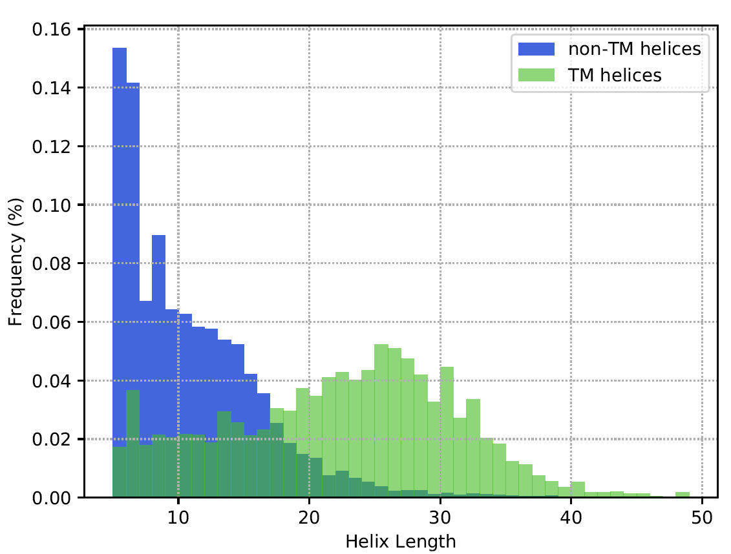
Differences TM vs non-TM
Amino Acid Composition
Helix length
Notes:
The preprocessed data has shown some interesting insights into the properties of transmembrane and non-transmembrane helices
The left plot shows the Amino acid composition of transmembrane helices in green and non transmembrane helices in blue. The darker green shows the overlap.
As can be seen some of the amino acids as for example Glutamic acid and Aspartic acid occur much more in non-transmembrane helices. In the plot above it can be seen that the amino acids that occur more often in non transmembrane helices are mostly hydrophilic. On the other hand the amino acids that occur more frequently in transmembrane helices as for example phenylalanine and leucine are mostly hydrophobic.
Furthermore the helix length show significant differences: as shown on the right plot the non transmembrane helices in blue containing around are usually shorter than the transmembrane helices where many contain more than 17 amino acids.
1:30 would be nice

Slide 6
Helix Classification
Features: Amino acid counts
Classifier: Support Vector Machine (SVM)
Notes:
Due to that insights we chose the features of our classifier: the amino acid counts which include both the length as well as the frequency information
For an independent evaluation we also split our dataset into a test and training set
The 70% training data was used for the training of an SVM and the parameter optimization which was done by a 5 fold cross validation

Slide 7
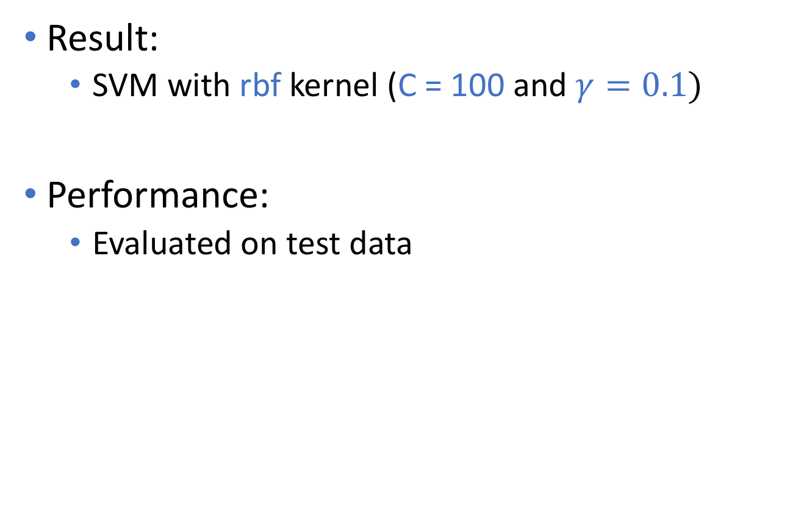
Helix Classification
Result:
SVM with rbf kernel (C = 100 and $γ=0.1)$
Performance:
Evaluated on test data
Sensitivity | Specificity | MCC
0.96 | 0.96 | 0.92
Notes:
This cross validation on the training set resulted in a SVM using rbf kernel with C=100 and gamme 0.1
The SVM achieved a sensitivity and specificity of 0.96 and a Matthews correlation coefficient of 0.92 which is a very high.

Slide 8
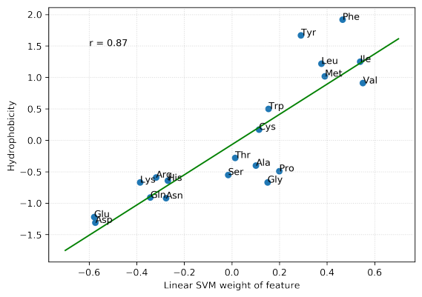
Linear SVM weights
SVM learned hydrophobicity measure without prior knowledge
Notes:
When we looked at the weights of the linear SVM which performed slightly worse than the rbf kernel SVM we saw a high correlation between the weights of each feature which was the amino acid frequency and the corresponding hydrophobicity measure. Therefore the SVM more or less learned the hydrophobicity measure without any prior knowledge.

Slide 9
Membrane geometry calculation
Preliminary geometry
Filter potential FP helices via angle and distance cutoffs
Remaining helices
→ first PCA loading vector = Membrane normal
Optimisation
Objective function: Q-value (Tusnády, 2004)
Sample test vectors in cone around normal vector
Take vector with highest Q-value

Slide 10
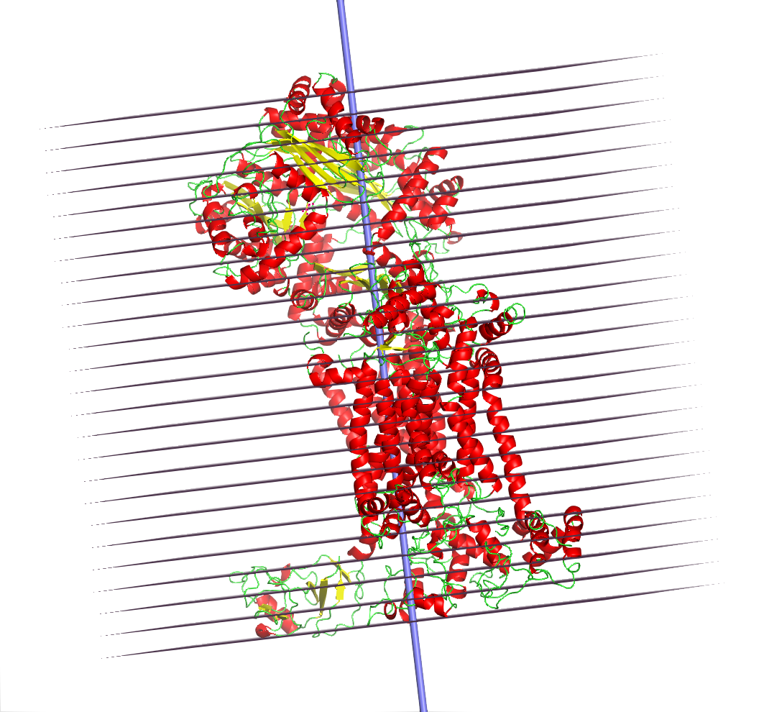
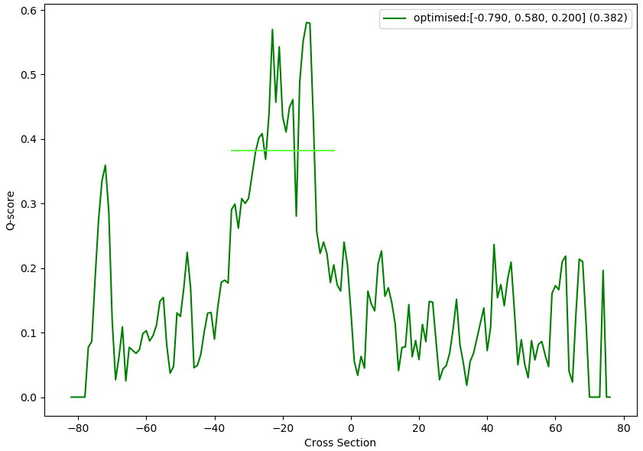
Membrane geometry calculation
Divide tertiary structure in slices
Calculate hydrophobic and geometric factors

Slide 11
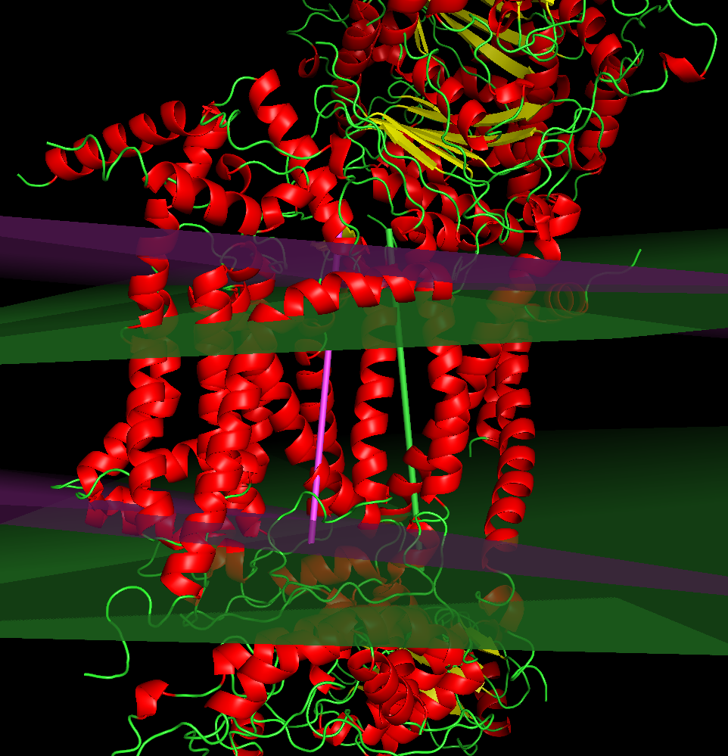
Optimisation result

Slide 12
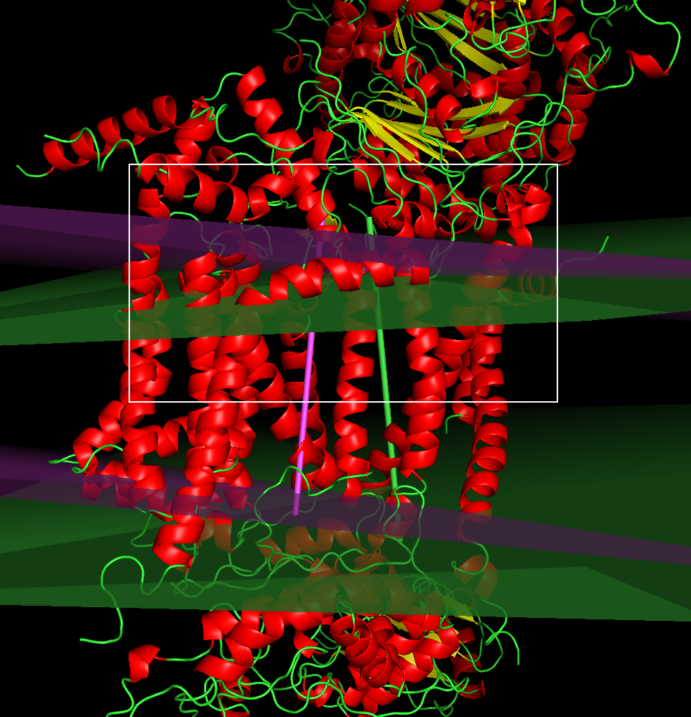
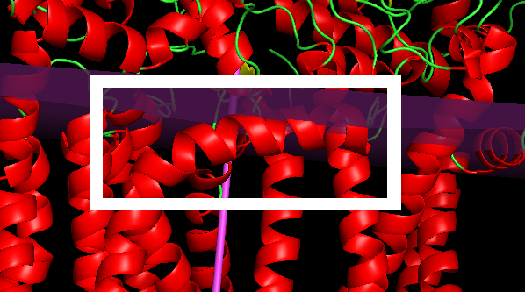
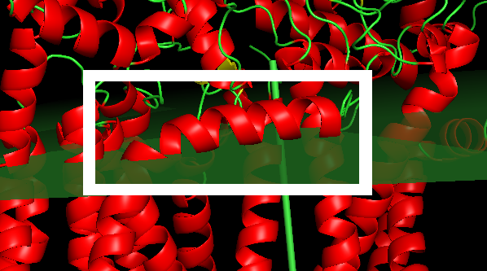
Optimisation result
Before
After

Slide 13
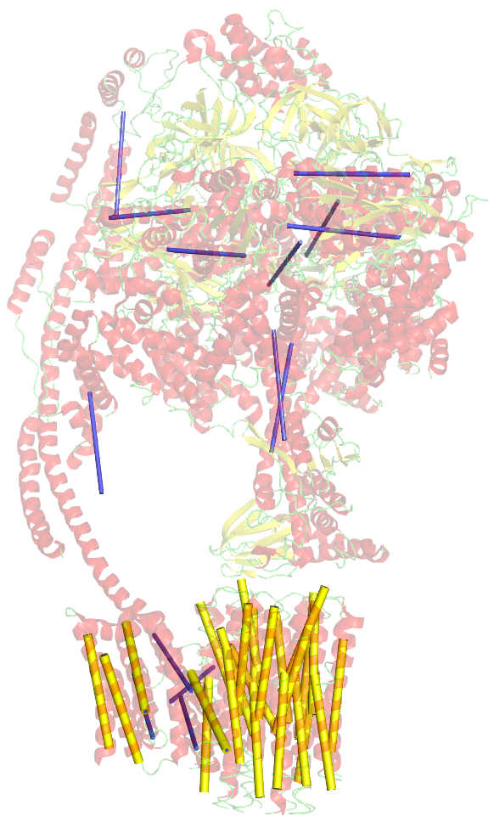
False Positive Removal
Angle and distance criteria filter False Positive helices quite reliably
This could be applied to refine the results of the classifier
5ARH
Blue: classified as TM, filtered out
Yellow: used for
membrane calculation

Slide 14
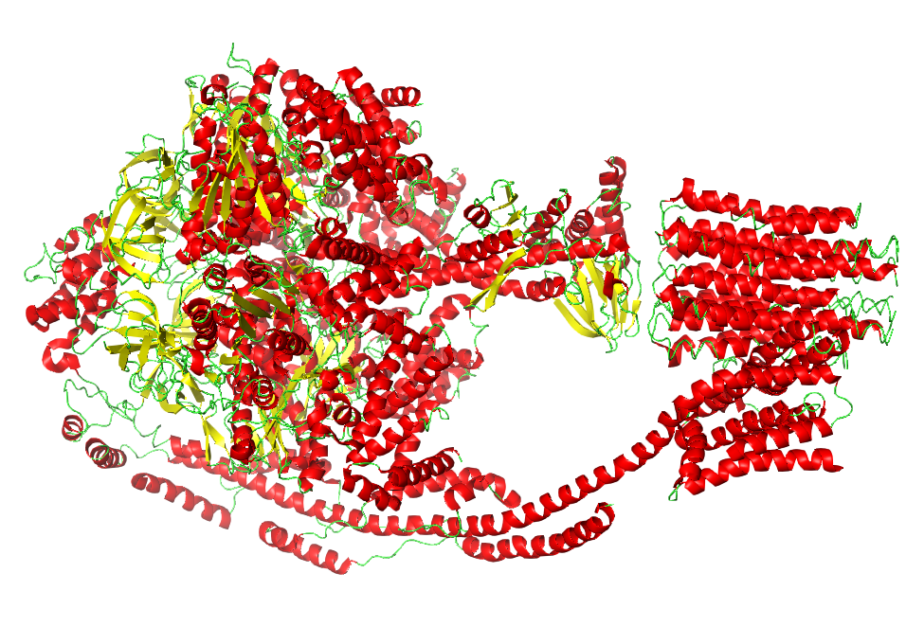
Protein 5ARH
(ATP synthase)

Slide 15
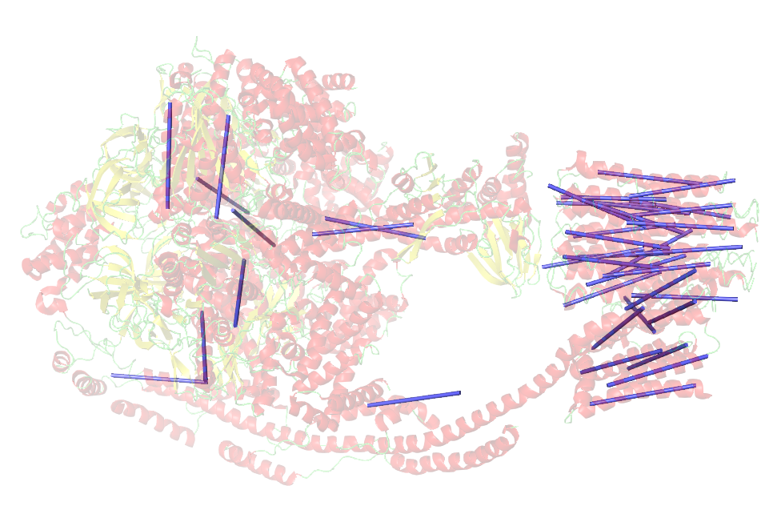
Helices classified
as transmembrane

Slide 16
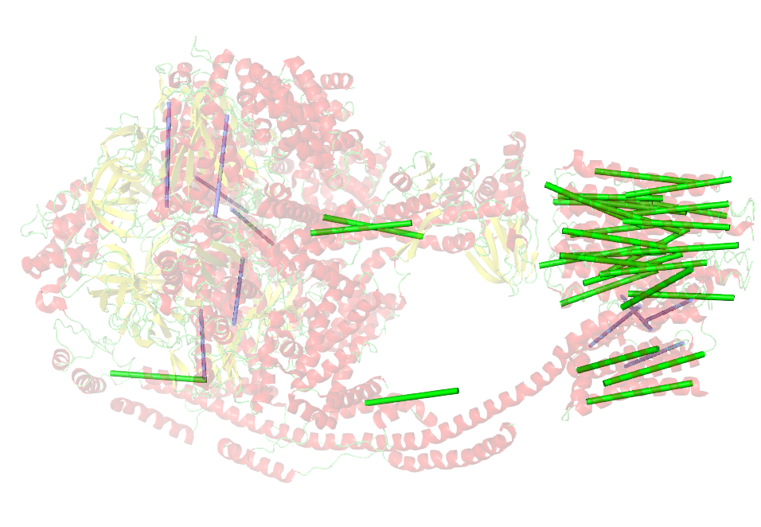
Filter 1:
by angle

Slide 17
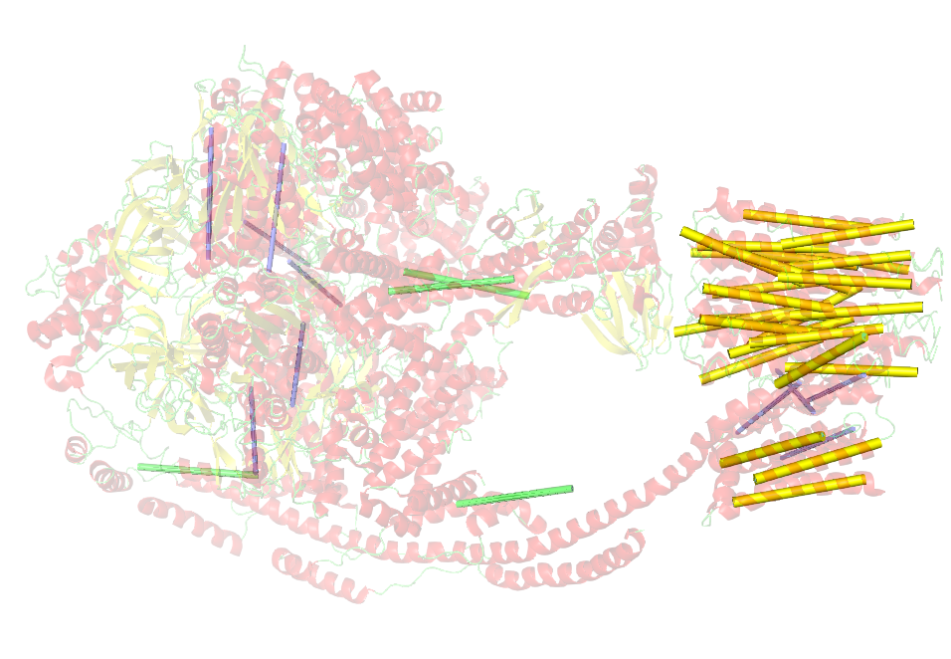
Filter 2:
by distance

Slide 18
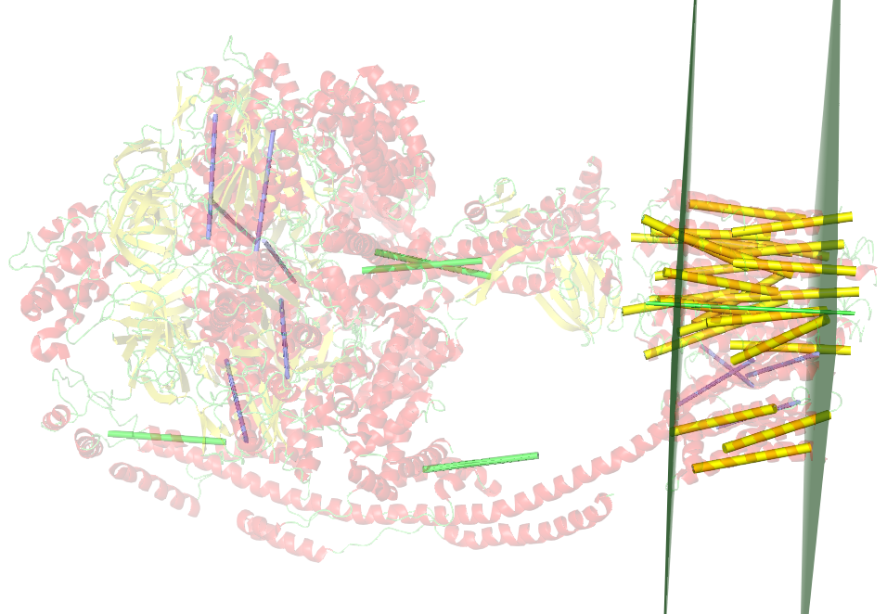
Membrane
calculation

Slide 19
Scores for non-TM proteins
Globulin -> 0.169
Hexokinase -> 0.162

Slide 20
Thank you for your attention!

